Slide 1
The Battle of Neighborhoods
An IBM Capstone Project

Slide 2
Introduction
Welcome to the world's most exciting city. The city of New-York. The city that doesn't need introduction. The city with a diversity of people and culture spread throughout. The city that never sleeps.
New-York is the financial capital of the United States of America - the biggest superpower in the world and hence one of the most expensive cities for small startups.
The analysis of which neighborhoods are best for startup of a certain type of business will result in reduced costs and higher return on investment to any new entrepreneur.

Slide 3
Problem Description:
In the city of dreams the immigration from various countries has been so high that it has influenced in building its diverse culture hugely. The city is full of all kinds of restaurants and Sushi joints are no different. They can be found on every nook and corner of the city. The problem that prevails here is to find a neighborhood that makes you stand out in your business and give the client a definite success
Here we are Analyzing for a client who wants to set up a restaurant i.e. a Sushi joint in Manhattan so we shall analyses that borough for neighborhoods suitable for his business.

Slide 4
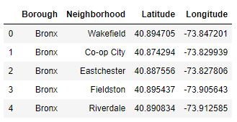
Data:
We shall be using New-York city as our playground for this particular project. We need the dataset containing longitudes and latitudes of each neighborhood in all of the 5 boroughs of New-York City. We shall use the following free dataset for that matter: https://geo.nyu.edu/catalog/nyu_2451_34572
Another data will be the data of longitudes and latitudes of neighborhoods fetched using the foursquare API

Slide 5
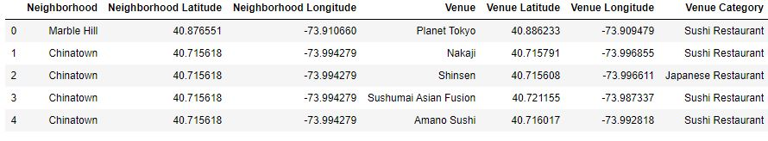
Data selection
Google map API is used to find the co-ordinates of the 5 shortlisted neighborhoods

Slide 6
Methodology:
Co-ordinates are generated for our addresses
Foursquare API is used to get the data for Manhattan for exploration purposes
Define and call a function to identify sushi restaurants in the neighborhoods

Slide 7
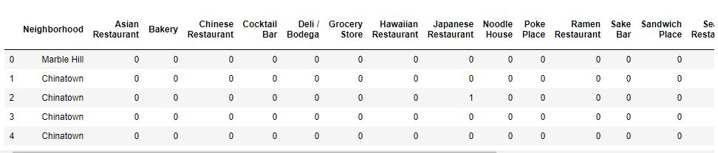
Methodology:

Slide 8
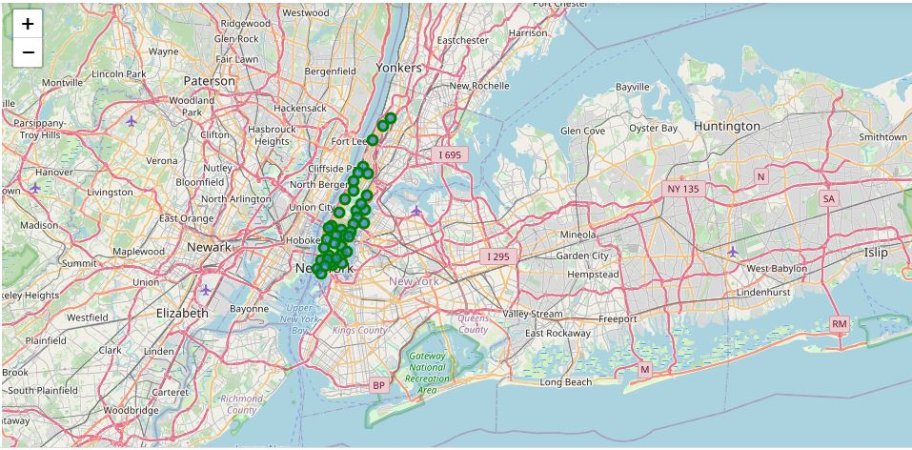
Methodology:
Sushi Bars in Manhattan

Slide 9
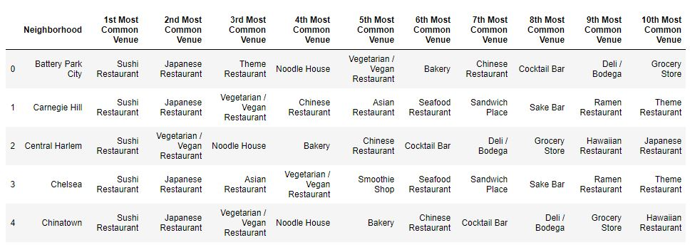
Methodology:
The next task is to perform clustering for which K-means clustering is used as we have the labelled data available making it easier with K-means clustering.

Slide 10
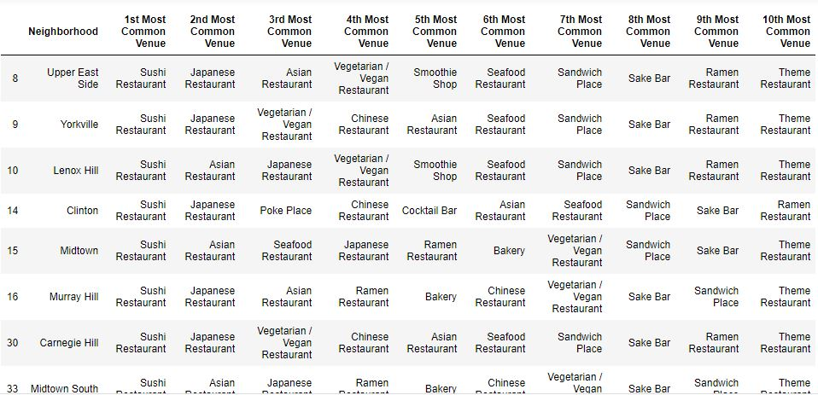
Cluster 0:

Slide 11
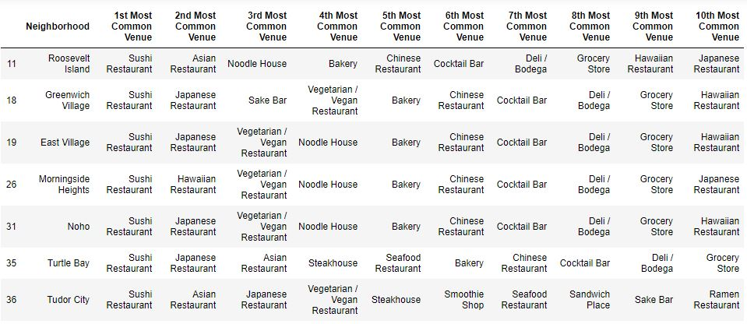
Cluster 1:

Slide 12
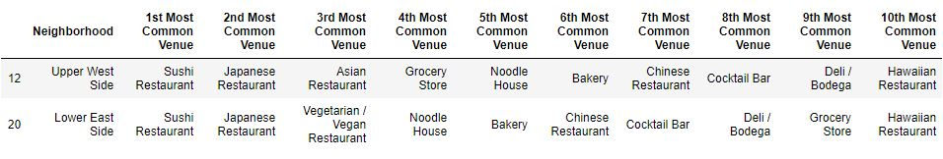
Cluster 2:

Slide 13
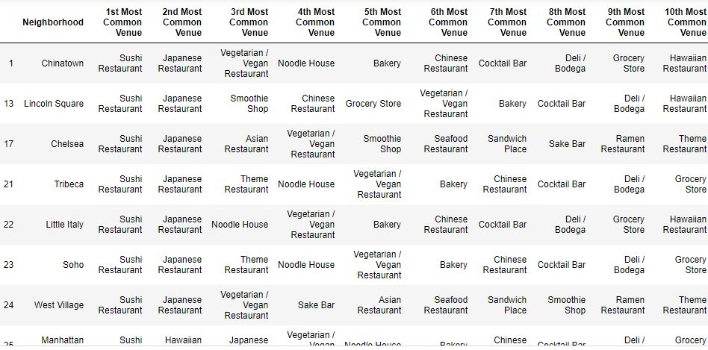
Cluster 3:

Slide 14
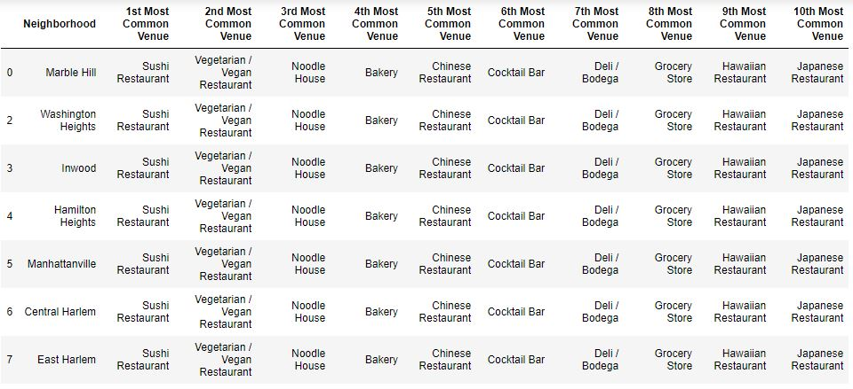
Cluster 4:

Slide 15
Discussion:
A rather wide and extensive data availability would make this project worth taking into consideration while starting up a new restaurant or a sushi joint in Manhattan and possibly New-York

Slide 16
Conclusion:
the Upper West side and Lower East side are the best areas for opening up a Sushi Bar as they have the least competition and crème customer availability.
This is evident on examining cluster 2
This project can be further Detailed into client requirements and can be processed as a full fledged AI application for data analysis and prediction using ML on Business startups in New-York
Reference: The idea for this project has been referenced from Mr. Ezgi Kaysikesler Github repository.

